Slide 1


Sentiment analysis using python
Team Members:
YATIN SINGH
AVI ALOK KULSHRESHTHA
DEVANSH GUPTA

Slide 2
PROBLEM STATEMENT

Slide 3
Now due to pandemic many of them have turned to e-commerce to buy and sell things.
Hence, there are wide range of product choices available to the users.
This is because same products are being by different sellers.
So, buyers are confused in buying which product and denying the same product sold by another seller.
Therefore, we as buyers must have a solution to overcome this problem.

Slide 4
Solution
SENTIMENT ANALYSIS

Slide 5
What is sentiment analysis?

Slide 6
Sentiment Analysis
It involves reading a block of text (in this case a review).
Then that block of text is parsed.
Based on that we classify the piece of text sentiment(review).
Sentiment can be classified into 2 types:
Positive
Negative
This is the basic overview of how an text can be classified based on the sentiment.

Slide 7
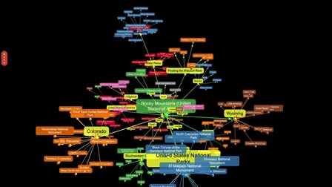
Disciplines involved

Slide 8
Disciplines Involved
Natural Language Processing
Classification
Deep Learning

Slide 9
Block Diagram

Slide 10
Block Diagram of Project
Reviews Dataset
Data Preprocessing
Reviews analysis
Sentiment based Classification
Results

Slide 11
WHY USE PYTHON?

Slide 12
Reasons:
-> Less Code, More Productivity
-> Flexible Paradigms (functional, procedural, object-oriented, user-friendly)
-> Open Source
-> Fast Development Cycles
-> Vast Range of Modules

Slide 13
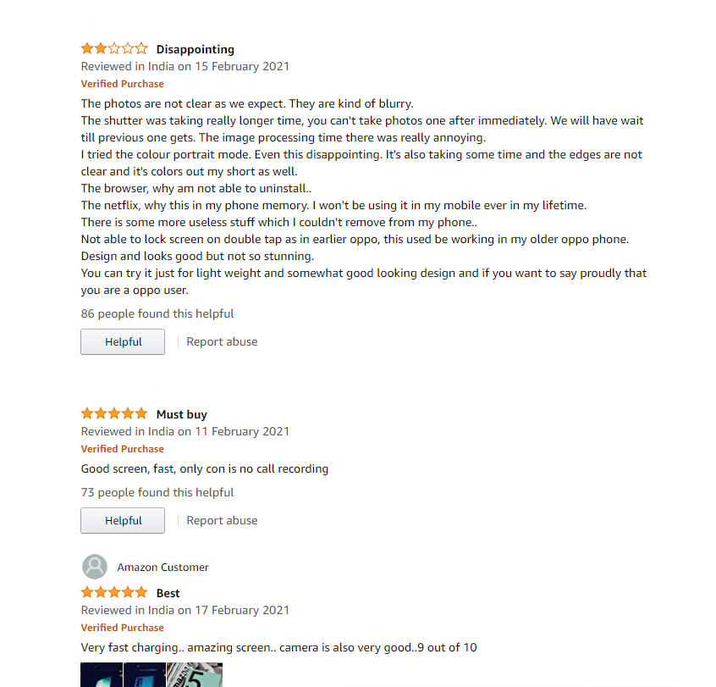
Review Types

Slide 14
Types of Reviews
Positive
This is a nice product.
Positive
(more)
This is nice product and has good reviews.
Negative
Product was good at the beginning but was bad later.
Negative
This is a bad project.

Slide 15
Algorithm

Slide 16
Algorithm used: Logistic Regression
Logistic regression is a statistical model that in its basic form uses a logistic function to model a binary dependent variable, although many more complex extensions exist.
In regression analysis, logistic regression (or logit regression) is estimating the parameters of a logistic model.
Syntax: ‘’from sklearn.linear_model import LogisticRegression’’

Slide 17
CODE EXECUTION
OF PROJECT

Slide 18
Q & A

Slide 19


